Slide 1




Slide 2



Slide 3
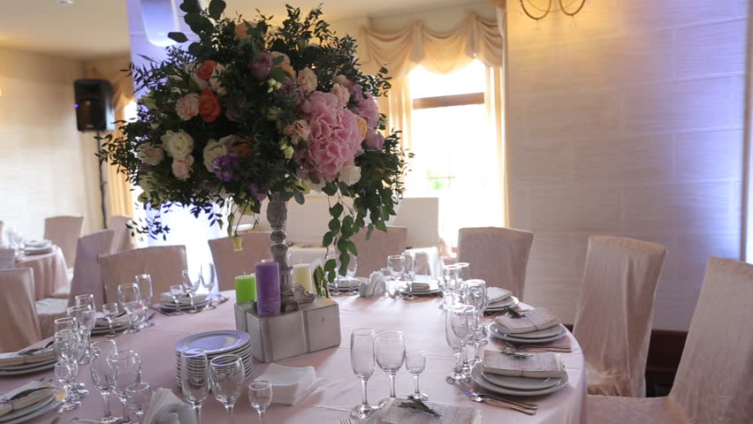
Unit 7

Slide 4

Opener

Slide 5
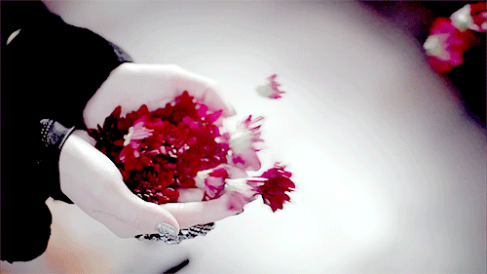
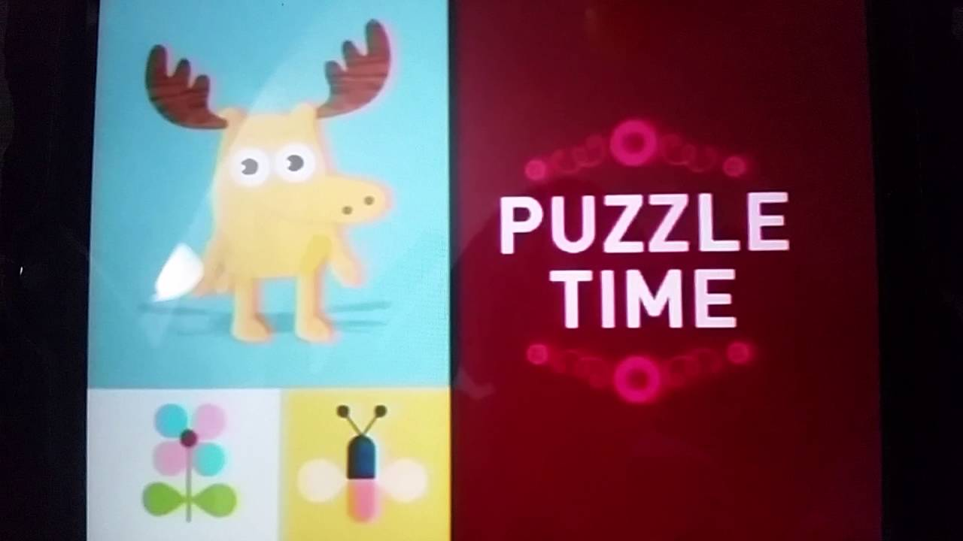

Slide 6
I am a 9 letter word.
👉 My first 4 letter is a part of a body.
👉 My last 3 letter is a number.
👉 If you lost me, it would be your worst nightmare .
👉Who I Am?

Slide 7
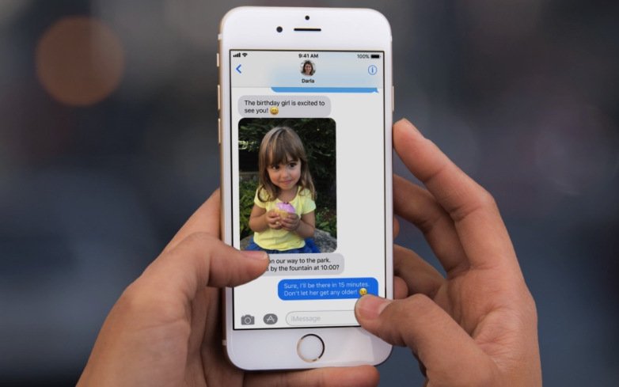
cellphone

Slide 8
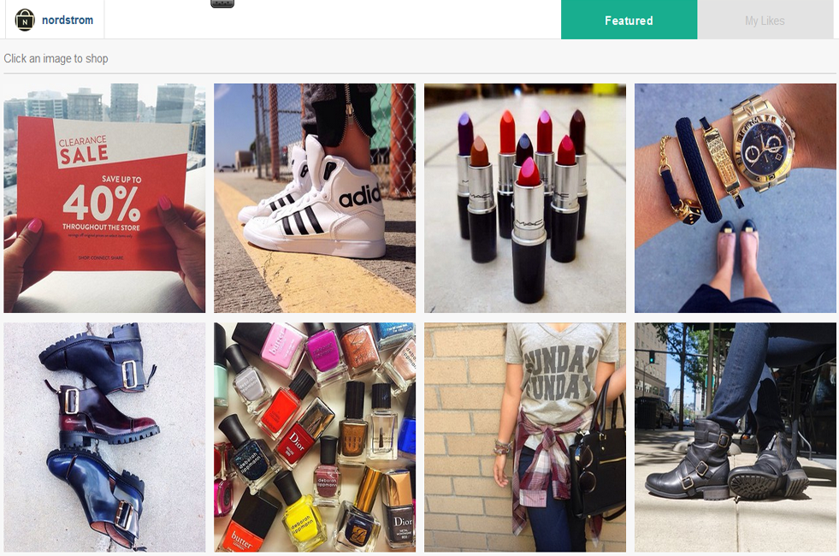

Do you like shopping online?

Slide 9

What would you like to order?

Slide 10

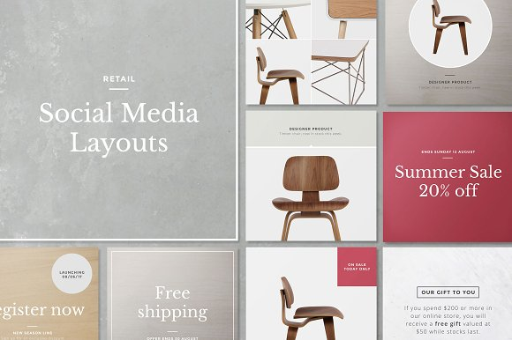
You can order the Italian furniture products on Instagram.

Slide 11
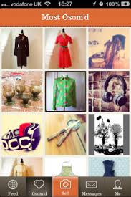
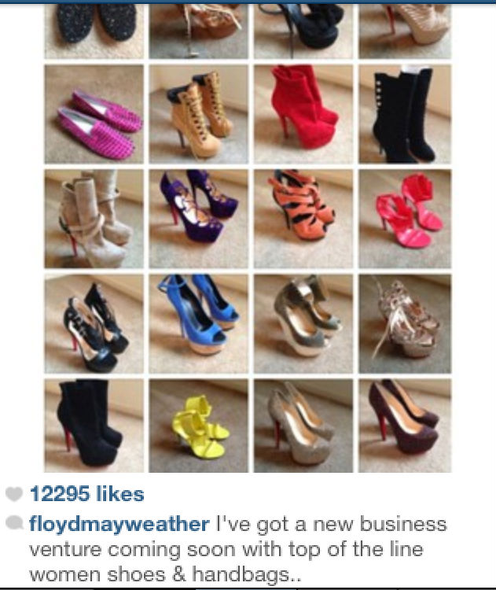


product
something that is made to be sold

Slide 12
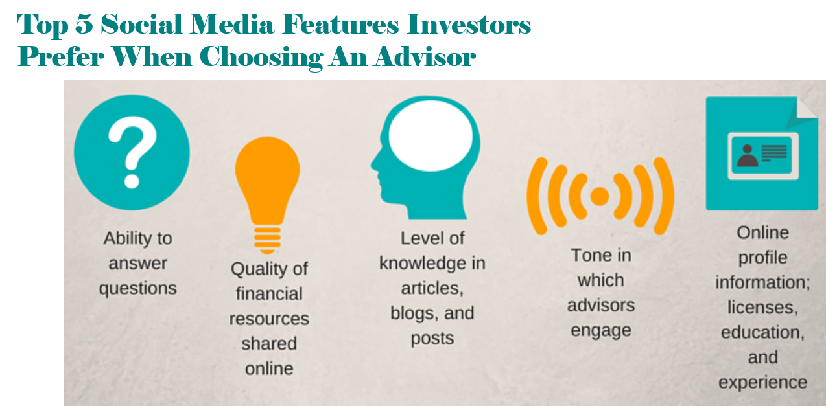
There are many features of social media which make it very useful.

Slide 13
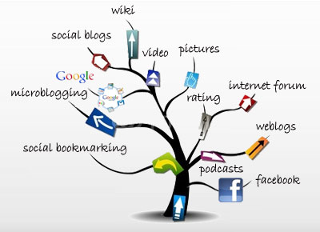

feature
a typical quality or an important part of something

Slide 14




Slide 15


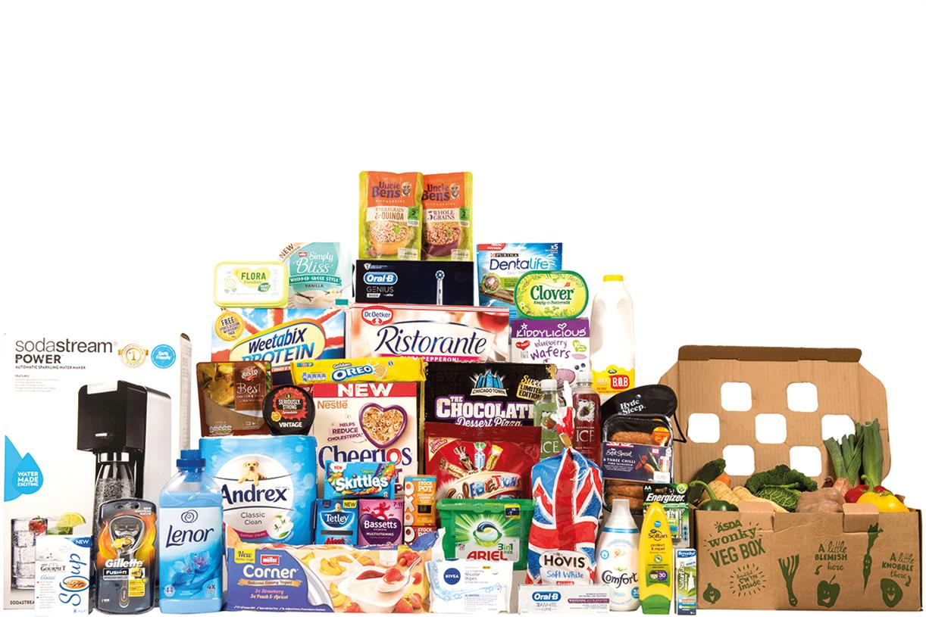
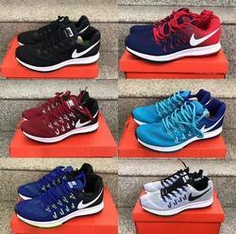
product (n.)
feature (n.)

Slide 16
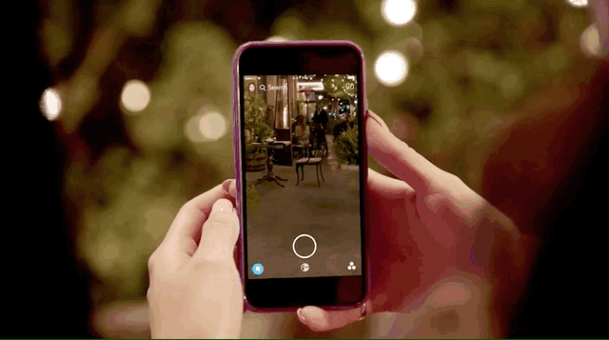
Student’s Book
Page 58

Slide 17



3. Grammar in context
Contrastive Connectors: although / however
e.g.: Although using technology excessively is unhealthy, using it in the right way can make life much easier.

Slide 18
3. Grammar in context
Contrastive Connectors: although / however
e.g.: Using technology in the right way can make life much easier, however using it excessively is unhealthy.

Slide 19



Slide 20

Read your answers.

Slide 21
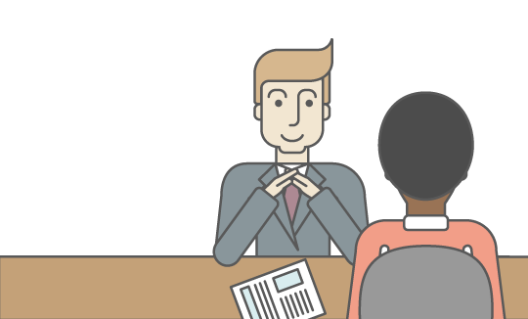

a. Complete the following sentences:
• …………………………….......…………, however, he didn’t get the job.
He has lots of experience, however, he didn’t get the job.

Slide 22

• …………………………….........…………, although it was raining.
They went outside, although it was raining.

Slide 23
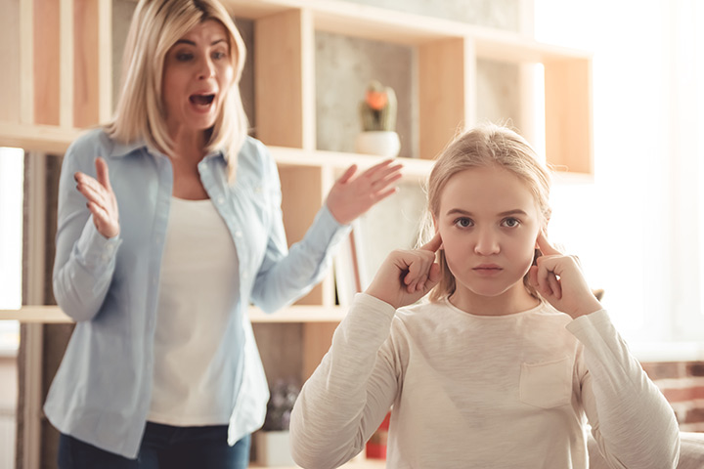
• Although she knew she was wrong, ………….…………….
Although she knew she was wrong, she didn’t apologise.

Slide 24
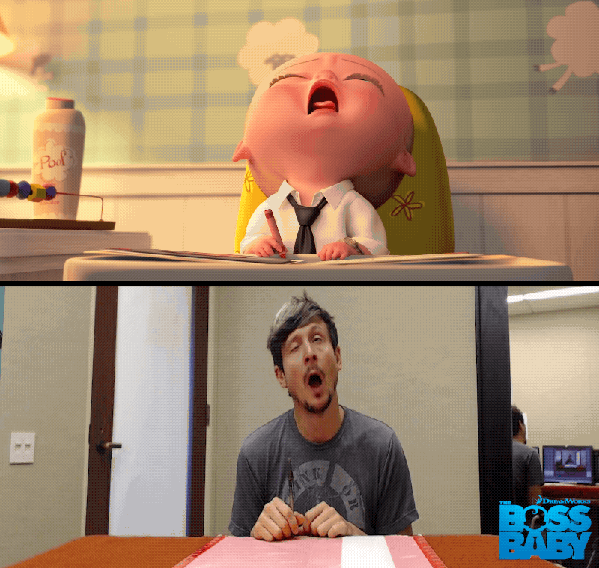
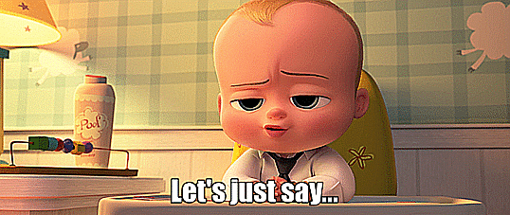
• I didn’t like the film, however, …………………………….
I didn’t like the film, however, my brother liked it
a lot.

Slide 25
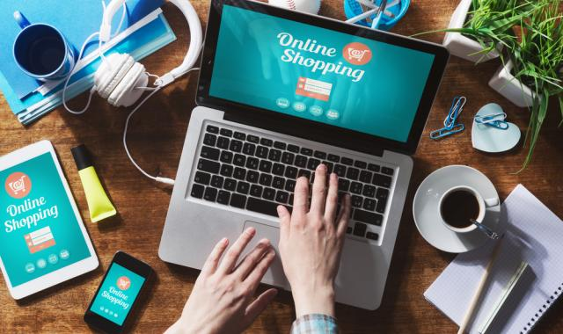


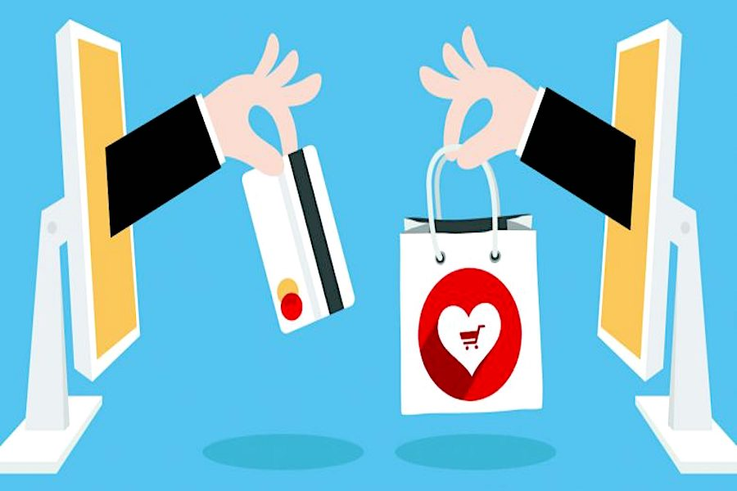
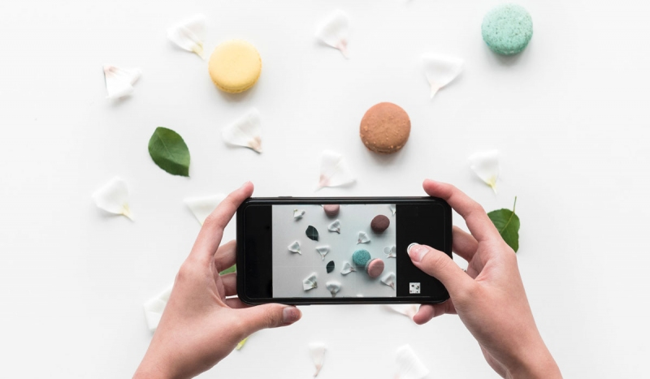

Slide 26


Slide 27

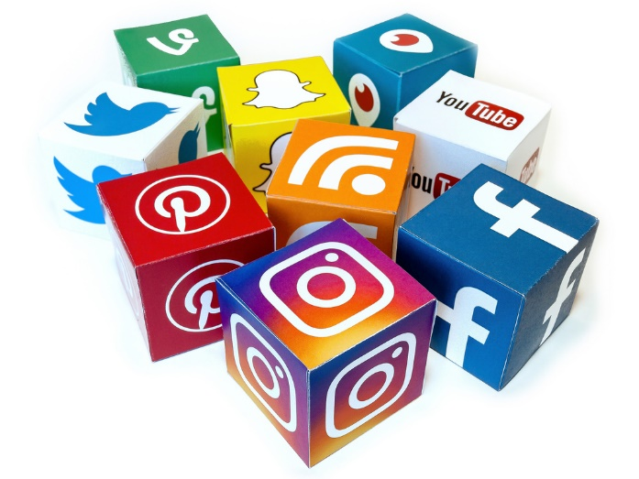
You are starting a small business with a group of friends and you want to advertise your product.
• Which social media would you choose?
• Discuss what specific features of that social media would make it useful.

Slide 28

Read your answers.

Slide 29
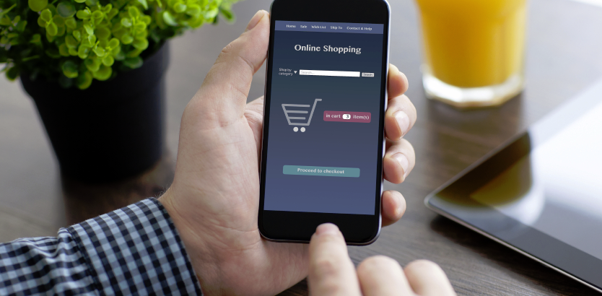
• What do you think of online shopping?

Slide 30

• Which social media would you choose?

Slide 31
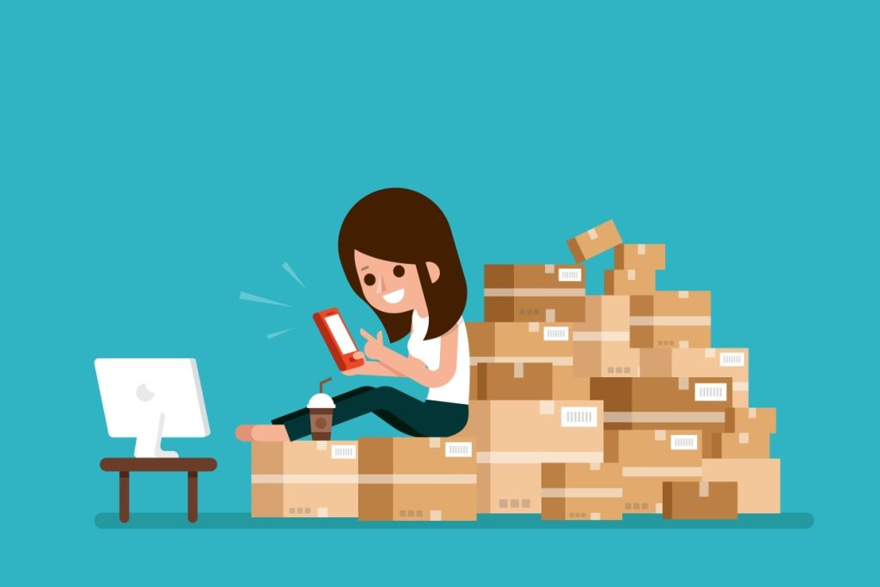
• Discuss what specific features of that social media would make it useful.

Slide 32
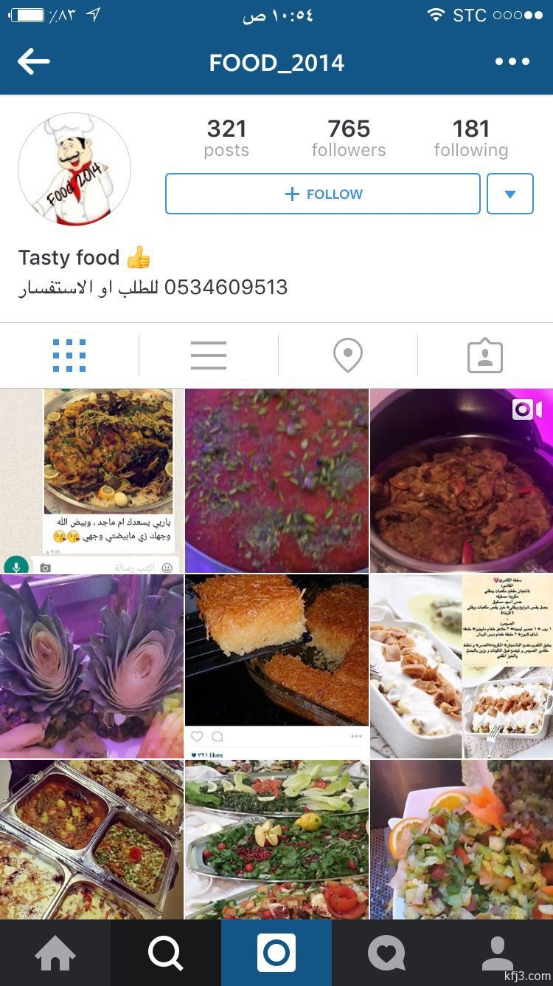

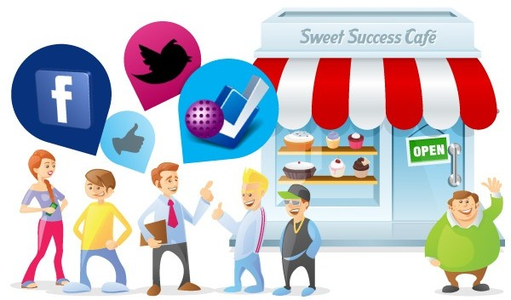
• Would you choose Snapchat or Instagram?

Slide 33
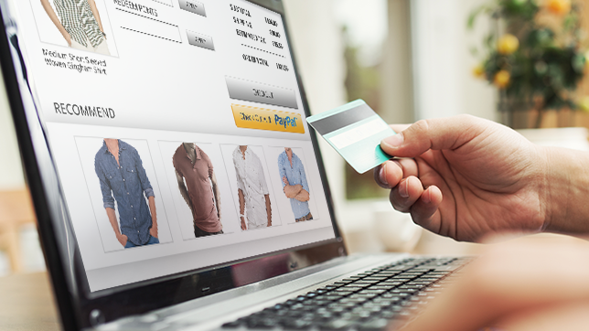
“Social media can be a blessing or a curse.”

Slide 35
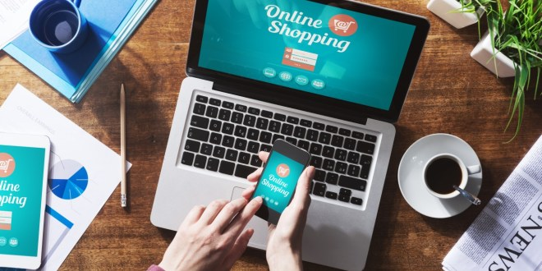
Read your answers.

Slide 36


“Social media can be a blessing or a curse.”
• Bringing people together
• Health problems
• Sharing information, photos and videos
• It can be dangerous if it is misused
• Sharing interests and hobbies
• Wasting a lot of time
• Building friendships
• Websites are not completely secure

Slide 37

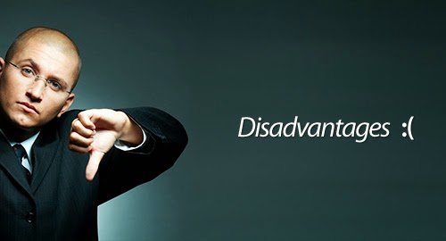
b. In your notebook, develop your notes into an argumentative paragraph explaining whether you are for or against social media.

Slide 38

Checklist:
Did I express my opinion in the topic sentence (for or against)?
Did I provide reasons and details to support my argument?
Did I conclude by summarizing my opinion in
a way readers will remember?

Slide 39
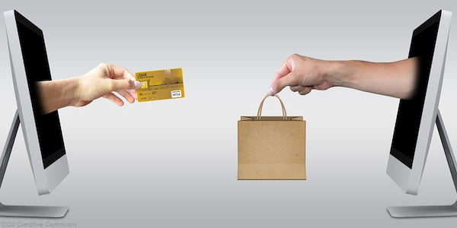
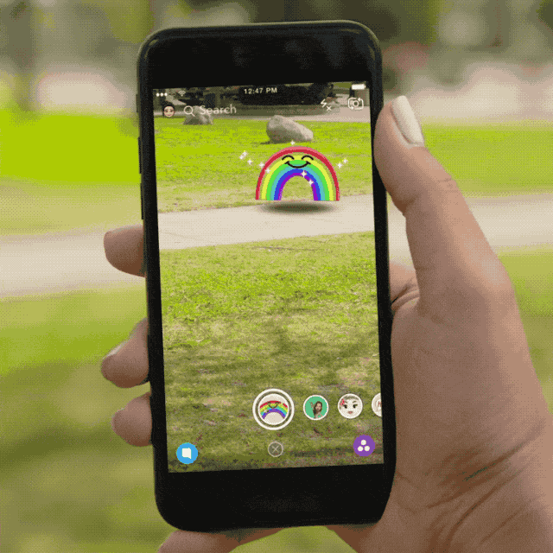
Closure

Slide 40
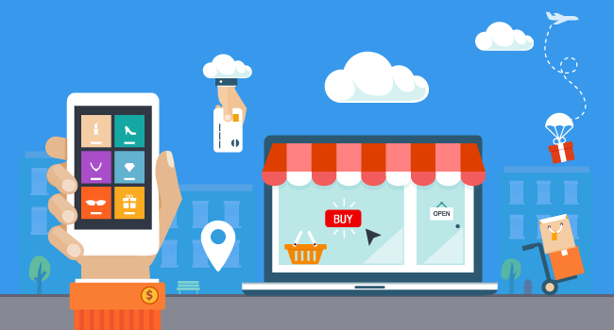
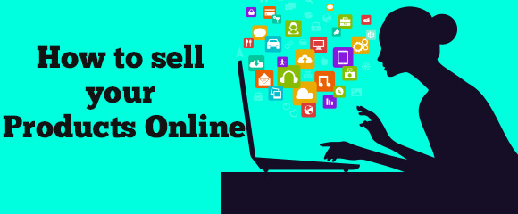
How can you sell your products online?

Slide 41

Thank you

